Slide 1
The biobased Economy in Europe –
Hype or realitiy ?
Perspectives for the Baltic regions
Riga, 8th of March, 2017
Dr. Dr. h.c. Christian Patermann
Director ret., EU-Commission
Member of the 1st Bioeconomy Council, Germany

Slide 2
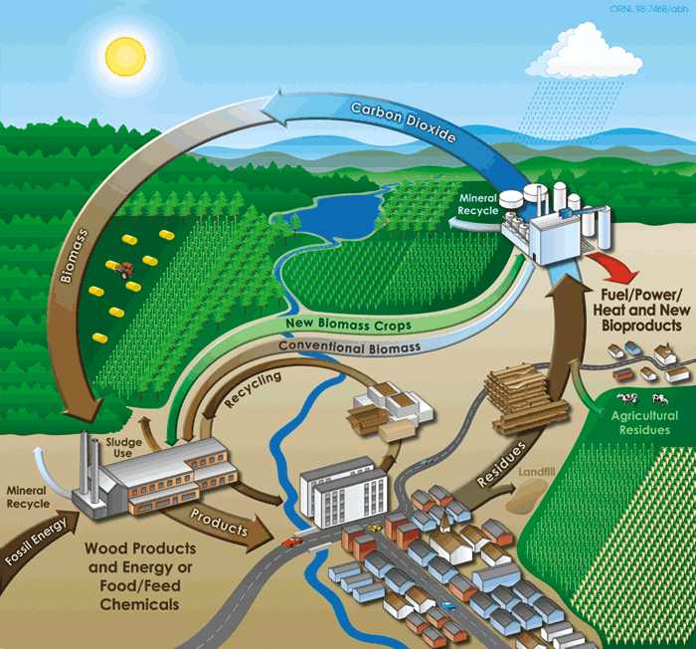
The Bioeconomy
Using research and innovation to produce renewable raw materials sustainably in agriculture, forestry, fisheries and aquaculture…
…and to process renewable raw materials into value added products in the food, bio-based and energy industries.
© Biopact

Slide 3
What is the Knowledge-Based Bio-Economy?
The knowledge base: Advances in Life Sciences and Biotechnologies in convergence with other technologies such as nanotechnologies, chemistry, information technologies..,
The Bio-Economy: Includes all industries and economic sectors that produce, manage or otherwise make use of biological resources including bio-waste.
The European Bio-Economy has an approximate market size of over
2.0 trillion € , employing more than 22 million people.
➔ 4 Fs: Food, Fees, Fiber and Fuel

Slide 4
Special features of the Bioeconomy
Biological resources, the heart of the bioeconomy, represent four unique functions or features:
Renewability
Carbon-friendliness or even carbon-neutrality
Strong potentials for efficient re- and multi-use, degradability, and recyclability in so-called cascade formats
New functions / properties of their products, like longerlifetime, higher durability and stability, lower or zero emissions, less or no toxicity, non-flammability etc.

Slide 5
What are the driving forces behind the Knowledge-Based Bio-Economy beyond competitiveness ?
Global challenges like :
Growing and aging populations
Increased demand for high quality food and sustainable food production
Increased incidence of food-related disorders (cardiovascular, obesity..)
Increased demand for feed
Increase in infectious animal diseases and zoonoses
Danger of plant diseases, new pathogens and pesticides
Limited resources of raw materials and energy
Threat of global warming and other global changes (biodiversity loss etc)

Slide 6
What is the Knowledge-Based Bio-Economy offering?
Improved health
Food with improved nutritional value, increased food safety, new treatments, diagnosis and vaccines against human and animal diseases, improved feed…
Sustainability and a cleaner environment
Energy and water saving production and processes in agriculture and industry ; carbon neutrality, decreased dependency of fossil resources;

Slide 7
What is the Knowledge-Based Bio-Economy offering?
Resource use efficiency: “More with less”
Innovation strategy
Support to rural development
Use of “set-aside” land; cultivation of new crops; decentralised production facilities
Increased industrial competitiveness through innovative eco-efficient bio-based products

Slide 8
The Knowledge-Based Bio-Economy also raises societal concerns
New issues arise, e.g.
use of human tissue and cells
use of personal and genetic data
food versus fuel
environmental issues incl. sustainable use of biomass in countries of the third world
animal welfare issues, incl. animal cloning
which require monitoring and informed societal debate on its benefits and risks

Slide 9
Present status of the bioeconomy
About 50 states worldwide and half a dozen regions officially support the bioeconomy either via dedicated programmes, strategies, action plans, roadmaps etc. or via closely related political, programmatic and/ or strategic activities, the majority of them still in Europe.
Many of these activities, however, are limited to biotechnology and/ or biofuels production and use.
Today, 10 years after it‘s launch there is no more a single bioeconomy but there are many bioeconomies!
This has an impact on the necessary frameworks, public funding, private investment and thematical content.

Slide 11
Present status (cont.)
Numerous biobased products are already in or are being brought to the market, resp. are in the pipeline. A vivid example: a booklet “Bioeconomy in everyday life“ or the so called “Bioeconomy appartment/ flat“ recently exhibited at the Brussel‘s event on investment and during the „Grüne Woche“/ Green Week in Berlin.
More than 50 chemical molecules are to be gradually replaced to be biobased, ranging from levulinic acid to succinic or acrylic acid etc.; very encouraging signs for the “greening“ of chemistry which will however be a long term process. A recent practical example: the commercialization campaign of biosurfactants by Evonik industries.

Slide 12
New trends
Industries broaden their portfolio of application more and more also to daily consumer goods, health care articles, cosmetics, cloths and garments. Examples go from biobased PET and PEF-bottles , shirts, eye-wear, shoeshine articles, rollers of longboards to biobased mortar and heat-damming , non flammable foams.
Strong trend to interesting cross-border cooperation and industrial take-overs, where Japan, ROC and Canada get more and more active.

Slide 13
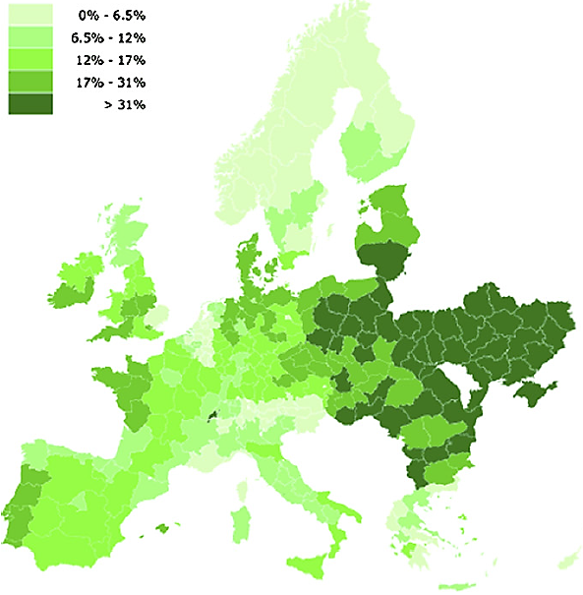
Exploiting potentials in regions …..
2010 'The ‘surplus’ land potentially available for the production of biomass by 2030' Wit+ Figure 8
"The production costs at which biomass resources are available in Europe are variable, with significantly lower costs in CEEC than WEC"
DG RTD

Slide 14
What does this all mean for the Baltic regions?
The Baltic regions offer a very good pole position to maximise and optimise the increased use of biological resources for new, maybe better sustainable and eco- friendly products and processes.
Reasons:
Large and yet largely unexploited reservoir of biomass, including organic waste and industrial residues.
Impressive coastal lines with yet untabbed potentials for blue Bioeconomy.
Relatively large reservoir of forests and wood.

Slide 15
What does this all mean for the Baltic regions?
Reasons (cont.):
Good scientific and technological knowledge on bioechnologies and converted technologies, like info and nano.
Good educational infrastructures all over the regions.
Closeness to the Baltic sea region as such and the Nordic council regions which offer by far the highest concentrations of states and regions owning already their own bioeconomy strategies
Build-up of a new Hansa-like cooperation net within all these regions
Benefit from these unique closeness and from the public openness and awareness of the potentials of the bioeconomy for these regions which prevail in that neighbourhood

Slide 16
Some obstacles to overcome
Little and rather undeveloped awareness among stakeholders on potentials of the bioeconomy for the Baltic and its regions.
Strong dominance of hitherto traditional agriculture and food industry as well as forestry and fisheries.
Strong dependence on fossil energies in some regions which will not easily and quickly changed in spite of general openness towards the increased use of renewable energies.
Deficit in private and also public capital to invest in RTDI and emerging industries.

Slide 17
What are potential measures to be undertaken?
Mapping of your strengths and weaknesses, also in combination with an differentiated in-depth analysis on the different potentials in the various regions. There are good practices: Nordrhein-Westfalen, Dutch provinces, Flanders, Mecklenburg-Vorpommerania, Nordic regions, like Iceland, Farör etc., Bavaria, Piemont and Emiglia-Romana in Italy, Champagne and Picardie in France.
Look for practices outside the Baltics and join forces in joint bi-and multilateral endeavour or with the assistance of EU, ESIF, EFRE, Horizon 2020. Do act!

Slide 18
What are potential measures to be undertaken?
Mobilize existing Committees and strategic bodies nationally to introduce potentials of the biobased economy, in relation to SD, Climate Change, Biodiversity, SME-support etc.
Focus on national advisory bodies.
Don’t forget educational measures, check potentials for master courses in circular and Bioeconomy or introduce relevant content into existing Curricula.
Start a public awareness campaign with politicians and NGO-s, if appropriate.
Mobilize old Technology platforms and modernize them !

Slide 19
Thank you very much for your attention.

